Slide 1

PromptPixel-Automatic Prompt Optimization and Image Generation
Vishwakarma Institute of Technology , Pune
Department of Information Technology
Guide :Prof. Kishor Pathak
Students Names :
1. Vishwatej Shende, 29, TY IT C , 12311483
2. Rishi Shendre, 30, TY IT C, 12310890
3. Anish Shete, 31, TY IT C, 12311245
4. Arya Shinde, 32, TY IT C, 12311643
5. Rutuja Solanke, 42, TY IT C, 12310185

Slide 2
Content
Introduction
Motivation
Literature Review
Research Gaps Identified
Objectives
Problem Statement
Proposed Methodology or System Design
Tools/Technologies Used
Project Flow Diagram
Results and Discussion
Conclusion
References:

Slide 3
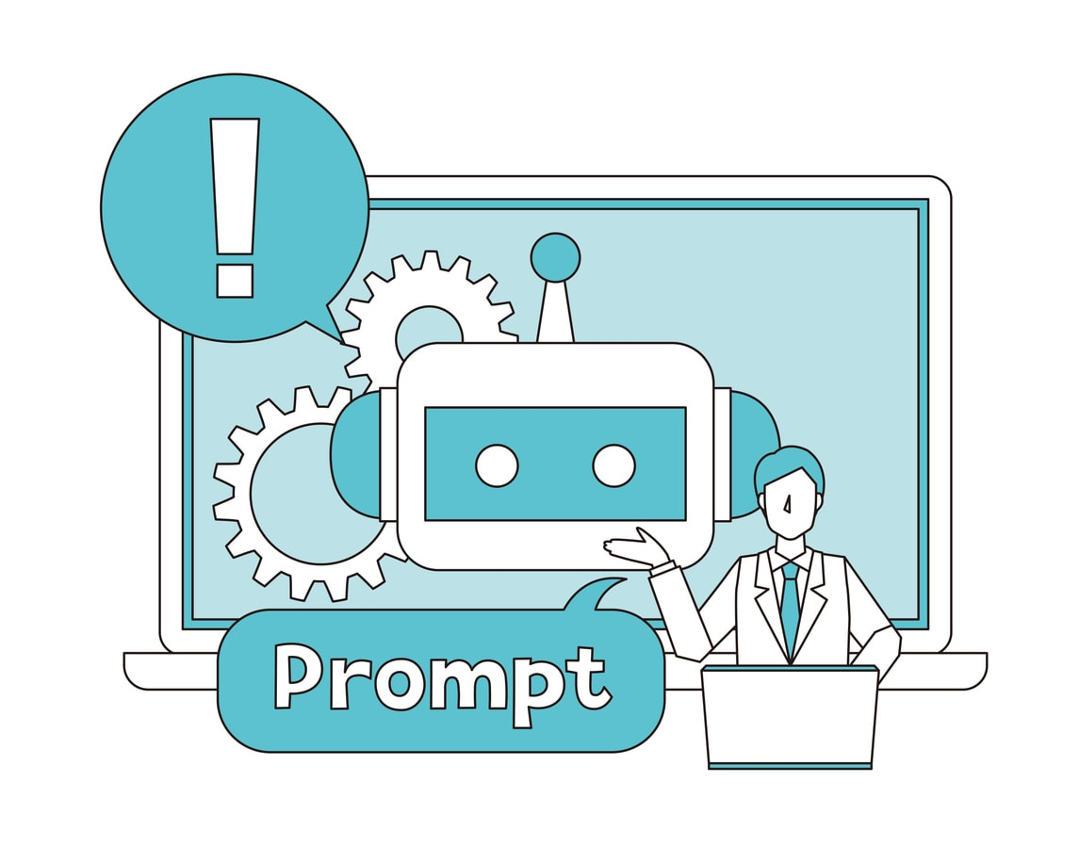
Introduction
PromptPixel – Automatic Prompt Optimization & Image Generation is an intelligent Generative AI platform designed to bridge the gap between user intent and high-quality AI-generated images.
Traditional AI image generators require detailed, technically structured prompts, which most users struggle to write.
PromptPixel solves this problem by automatically transforming simple, conversational descriptions into optimized, professional-grade prompts using advanced language models like GPT-4.
Unlike black-box systems, it provides transparency by showing both original and enhanced prompts, allowing users to edit, learn, and improve their prompt-writing skills.
The platform combines automation, transparency, and education into a single seamless creative workflow.

Slide 4
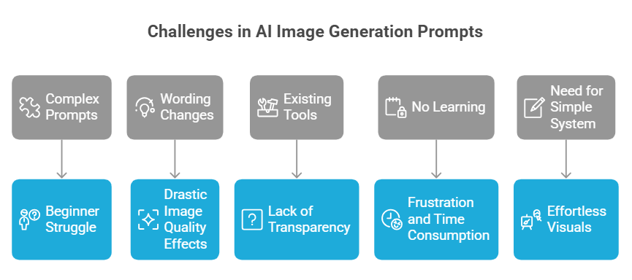
Motivation
Most AI image generators require complex, technical prompts that beginners struggle to write.
Small changes in wording can drastically affect image quality and results.
Existing tools enhance prompts automatically but do not show how or why improvements are made.
Users cannot learn prompt engineering due to lack of transparency.
Iterating on bad results is frustrating and time-consuming.
There is a need for a simple, transparent system that turns ideas into high-quality visuals effortlessly.

Slide 5
Literature Review
Title | Citation (Author et al. / Year) | Objectives claimed by authors in their paper | Methodologies used | Outcomes (from result & Discussion) | Gap Identified (Generally from Conclusion & Future scope)
IPGO: Indirect Prompt Gradient Optimization for Parameter-Efficient Prompt Level Fine-Tuning on Text-to-Image | Ye et al. (2025) – IPGO | Improve prompt embeddings for text-to-image models to better align with aesthetics and human preferences | Introduced Indirect Prompt Gradient Optimization (IPGO): low-rank prompt tokens with gradient-based updates; evaluated with multiple reward models | IPGO outperforms baseline prompt techniques (training-free & training-based) in aesthetic, alignment, and preference scores | Needs further exploration of computational trade-offs & broader model generalization
TIPO: Text to image with Text Presampling for prompt optimization | Yeh et al. (2024) – TIPO | Enhance text-to-image generation by optimizing prompts automatically without heavy runtime cost | Text Presampling for Prompt Optimization (TIPO): refine user prompts using trained prompt distributions instead of LLMs/RL | Improved aesthetic and alignment with target dataset; reduces corrupted or misaligned outputs | Exploration needed on scalability and cross-dataset generalization
Improving text to image generation with input side inference time Scaling | Chen et al. (2025) – Prompt Rewriter | Refine user prompts using LLM-based prompt rewriting to improve image generation quality | Iterative prompt rewriting with reward system and Direct Preference Optimization (DPO) | Consistent quality improvement in alignment and aesthetics across T2I models; strong transferability | Further work on optimizing reward design and scaling with larger LLMs

Slide 6
Literature Review
Title | Citation (Author et al. / Year) | Objectives claimed by authors in their paper | Methodologies used | Outcomes (from result & Discussion) | Gap Identified (Generally from Conclusion & Future scope)
A Survey of Automatic Prompt Engineering: An Optimization Perspective | Li et al. (2025) – Survey: Automatic Prompt Engineering | Categorize automated prompt optimization techniques across modalities from an optimization perspective | Systematic analysis across evolutionary, gradient, RL, and hybrid methods | Unified view of prompt optimization as an optimization problem; highlights benefit across text and multimodal tasks | Underexplored areas: constrained optimization & agent-oriented prompt design
A Systematic Survey of Automatic Prompt Optimization Techniques | Ramnath et al. (2025) – Systematic Survey of APO | Survey Automatic Prompt Optimization (APO) techniques broadly for LLMs and prompt improvement | 5-part framework; comparisons of RL, genetic, and neural approaches; structured taxonomy | Identifies trends & limitations in current APO; calls attention to extension to multimodal systems | Significant gaps: multimodal APO (e.g., text->image/audio), task-agnostic efficacy, scalability

Slide 7
Literature Review
Title | Citation (Author et al. / Year) | Objectives claimed by authors in their paper | Methodologies used | Outcomes (from result & Discussion) | Gap Identified (Generally from Conclusion & Future scope)
RePrompt: Automatic Prompt Editing to Refine AI Generative Art Towards Precise Expressions | Wang et al. / 2024 | Improve emotional expressiveness of AI-generated images by automatically refining text prompts | Curated text features (noun count, concreteness); trained proxy model; used model explanations to build a rubric for prompt editing | IPRePrompt significantly improved emotional expressiveness of generated images, especially for negative emotions (simulation + user study validated) | Handling complex multi-emotion prompts; expanding beyond emotion to other semantic aspects of image expression
Lumina Image 2.0: A unified and Efficient Image Generative Framework | Qin, Zhuo et al./2025 | Build a unified, efficient text-to-image framework with better prompt adherence and scalability | Unified Next-DiT architecture (joint text-image tokens); UniCap captioning system; multi-stage progressive training + inference acceleration | Strong performance on benchmarks with only 2.6B parameters; faster convergence, better prompt adherence, scalable design | Extending unified architecture to video/multimodal tasks; further scaling and real-world deployment
Prewrite: Prompt Rewriting with Reinforcement Learning | Kong et al. /2023 | Automate prompt rewriting using RL to replace manual trial-and-error prompt engineering | LLM-based prompt rewriter trained via Reinforcement Learning on downstream task performance | PRewrite outperformed manual prompts on diverse benchmark datasets, showing automated rewriting is effective and consistent | Generalizing across all LLM types; handling highly domain-specific or complex task prompts with RL stability

Slide 8
Literature Review
Title | Citation (Author et al. / Year) | Objectives claimed by authors in their paper | Methodologies used | Outcomes (from result & Discussion) | Gap Identified (Generally from Conclusion & Future scope)
Learning from Contrastive Prompts: Automated Optimization and Adaptation | Li et al. / 2024 | Improve prompt optimization by learning from both good and bad prompts, and enable prompt adaptation across model versions and languages | Contrastive learning framework (LCP) that analyzes patterns in good vs. bad prompt examples; evaluated on Big-Bench Hard dataset | LCP achieved 76%+ win rate over existing methods; showed strong adaptability across model versions, families, and languages | Existing methods only learn from incorrect samples; no prior work addressed prompt adaptation across newer model versions or different languages
Prompt Optimization via In Context Learning | Do, Zhao et al. / 2024 | Optimize prompts for in-context learning using adversarial learning between a generator and discriminator LLM | Two-player adversarial game: generator produces output, discriminator classifies it; a prompt modifier LLM proposes edits based on adversarial loss | Significant improvements over state-of-the-art on 13 tasks (summarization, reasoning, translation, MMLU, Big-Bench Hard); effective in low-resource settings | Adversarial learning not yet applied to broader multi-modal or complex multi-step reasoning tasks; extensibility to very large-scale models needs further study

Slide 9
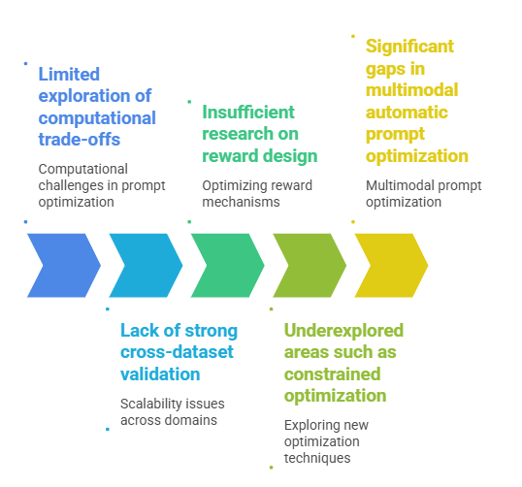
Research Gaps Identified

Slide 10
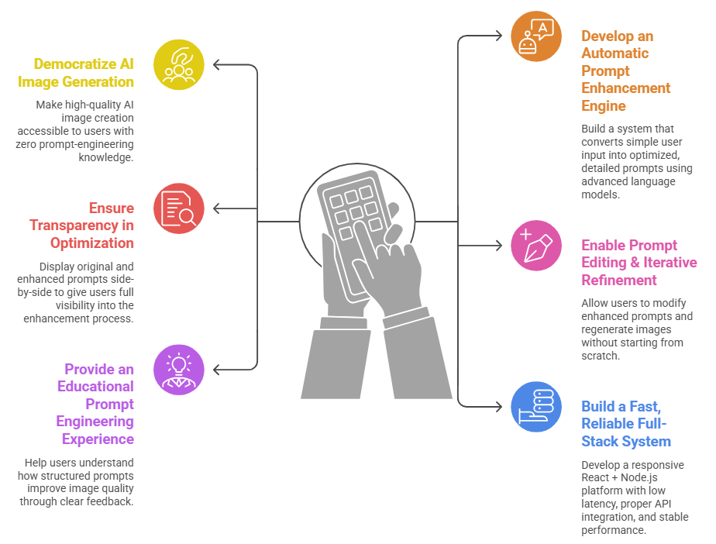
Objectives

Slide 11
Problem Statement
There is a need for a transparent and user-friendly system that enables non-experts to generate high-quality AI images through simplified and guided prompt optimization.
Elaboration:
Most AI image generation tools require detailed, technical prompts that beginners struggle to create.
Existing automatic prompt enhancement systems function as black boxes with no visibility into how prompts are improved.
Users cannot learn or refine their prompt-writing skills due to lack of transparency and feedback.
Iterative improvement is inefficient, forcing users to repeatedly rewrite prompts from scratch when results are unsatisfactory.

Slide 12
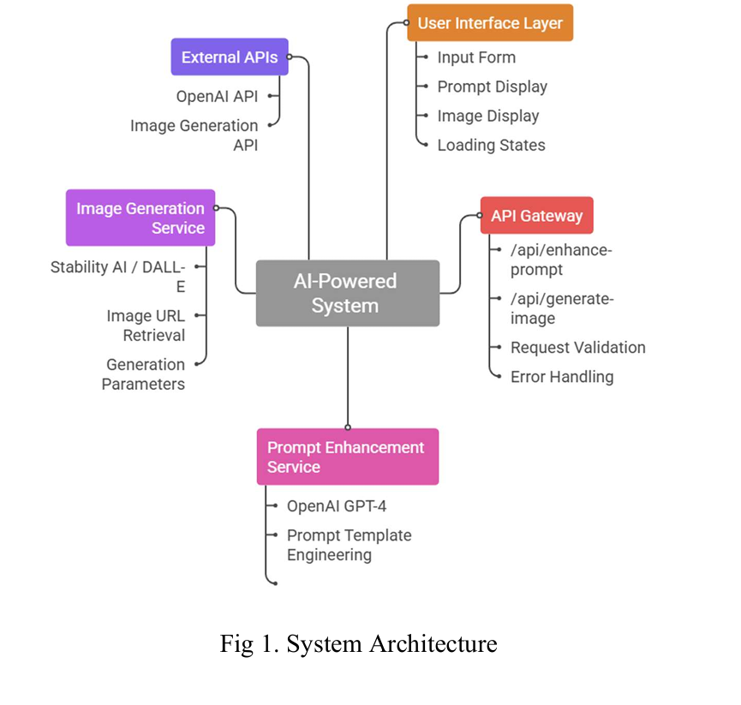
Proposed Solution

Slide 13
Tools and Tech
Category | Technologies Used
Frontend | React 18, Vite
Backend | Node.js, Express.js, OpenAI API, Image Generation API, Python
Deployment | Git, GitHub, Render

Slide 14
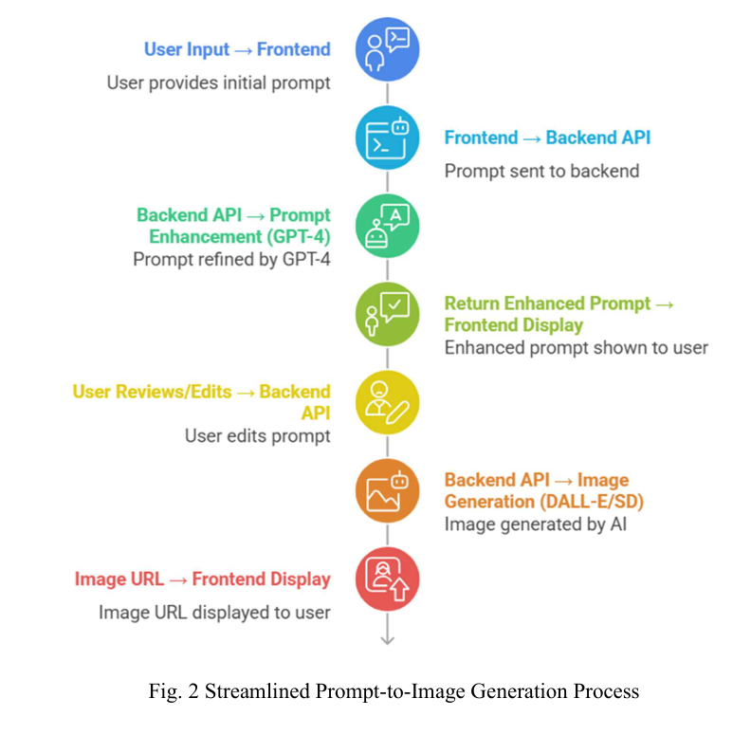
Project Flow

Slide 15
Conclusion
PromptPixel demonstrates how AI-powered image generation can be integrated into a full-stack application using a modern web architecture.
The system allows users to enter prompts and generate images instantly, improving creativity and rapid content creation.
By integrating a backend API with database storage using MongoDB, all generated images and prompts can be saved and displayed efficiently.
The project highlights the practical use of AI APIs, backend services, and frontend frameworks working together in a real-world application.
Overall, PromptPixel shows how AI tools can enhance user interaction and automate creative tasks, making digital content generation faster and more accessible.

Slide 16
References
References:
[1] H. Ye, J. Zhang, L. Wang, and Q. Liu, “IPGO: Indirect Prompt Gradient Optimization for Text-to-Image Generation,” arXiv preprint arXiv:2503.21812, 2025, pp. 1–12.
[2] C. Yeh, Y. Lin, and M. Sun, “TIPO: Text Presampling for Prompt Optimization in Text-to-Image Generation,” arXiv preprint arXiv:2411.08127, 2024, pp. 1–10.
[3] Z. Chen, H. Li, R. Xu, and T. Zhao, “Prompt Rewriter: Automated Prompt Optimization using Direct Preference Optimization for Text-to-Image Models,” arXiv preprint arXiv:2510.12041, 2025, pp. 1–14.
[4] X. Li, Y. Zhou, and K. Chen, “A Survey of Automatic Prompt Engineering: An Optimization Perspective,” in Proc. Int. Conf. Artificial Intelligence and Machine Learning (ICAIML), 2025, pp. 45–60.
[5] S. Ramnath, P. Gupta, and A. Verma, “A Systematic Survey of Automatic Prompt Optimization Techniques for Large Language Models,” arXiv preprint arXiv:2502.16923, 2025, pp. 1–20.

Slide 17
References
References:
[6] Y. Wang, S. Shen, and B. Y. Lim, "RePrompt: Automatic Prompt Editing to Refine AI-Generative Art Towards Precise Expressions," in Proceedings of the CHI Conference on Human Factors in Computing Systems (CHI), 2024.
[7] Q. Qin, L. Zhuo, Y. Xin, R. Du, Z. Li, B. Fu, Y. Lu, J. Yuan, X. Li, D. Liu, X. Zhu, M. Zhang, W. Beddow, E. Millon, V. Perez, W. Wang, C. He, B. Zhang, X. Liu, H. Li, Y. Qiao, C. Xu, and P. Gao, "Lumina-Image 2.0: A Unified and Efficient Image Generative Framework," arXiv preprint arXiv:2503.21758, Mar. 2025.
[8] W. Kong, S. Amba Hombaiah, M. Zhang, Q. Mei, and M. Bendersky, "PRewrite: Prompt Rewriting with Reinforcement Learning," in Proceedings of the Annual Conference of the North American Chapter of the Association for Computational Linguistics (NAACL), 2024.
[9] M. Li, A. Ahmad, K. Aggarwal, Y. Xie, and S. Lau, "Learning from Contrastive Prompts: Automated Optimization and Adaptation," arXiv preprint arXiv:2409.15199, Sep. 2024.
[10] X. L. Do, Y. Zhao, H. Brown, Y. Xie, J. X. Zhao, N. F. Chen, K. Kawaguchi, M. Shieh, and J. He, "Prompt Optimization via Adversarial In-Context Learning," arXiv preprint arXiv:2312.02614, Jun. 2024.

Slide 18
Thank You

